Slide 1
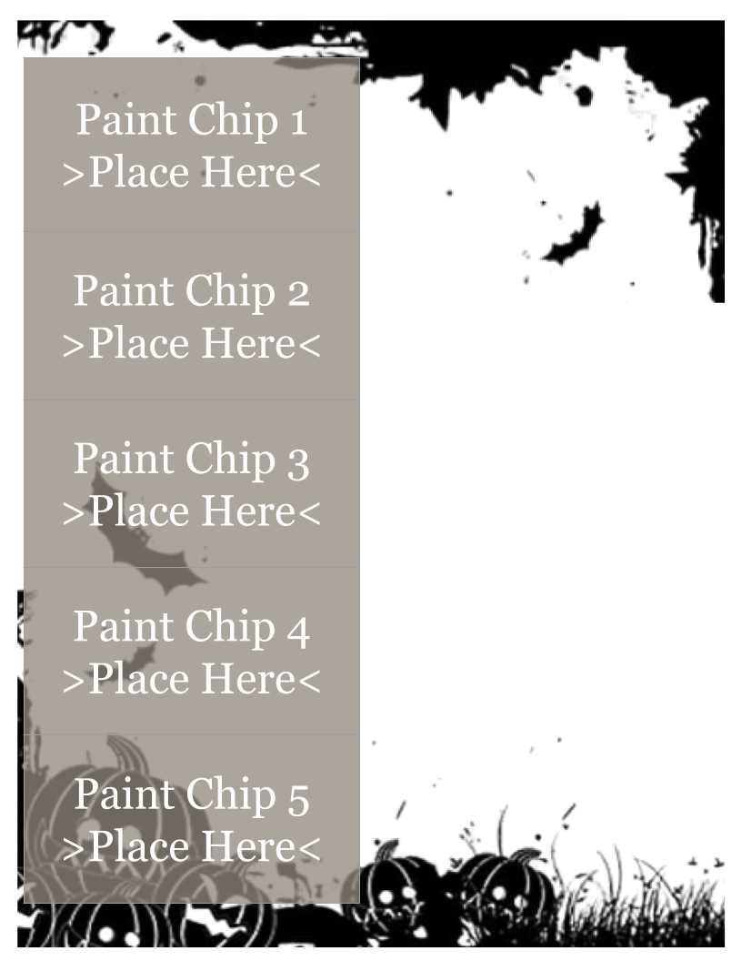

























Choose five (5) spooky paint chips.
Drag and drop them next to the line in which you will use it.
Create a poem that uses the phrases on the paint chips.
Highlight the paint chip words in your finished poem.
Write the first line of your poem here.
Write the second line of your poem here.
Write the third line of your poem here.
Write the fourth line of your poem here.
Write the fifth line of your poem here.

Slide 2
